Slide 1

Customer Segmentation
By: Basit Aroworowon and John Cuccolo

Slide 2
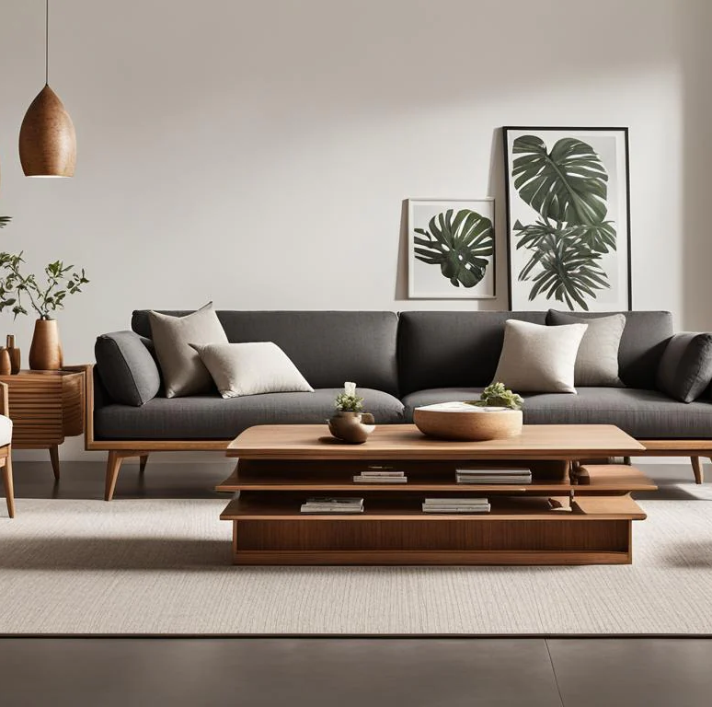
Purpose of the Study
The purpose of this research is to find the relationship in the dataset, with the use valuable information we can analyze customer behaviors and characteristics in the retail furniture industry, with the details that identify patterns in customer demographics, purchasing habits, and preferences, allowing businesses to perform effective customer segmentation

Slide 3
Key Analysis
In this Analysis we would be using the educational aspect of the customer, work type / experience and spending score to help determine the best business strategy to help retain customer while increasing revenue and profit.

Slide 4
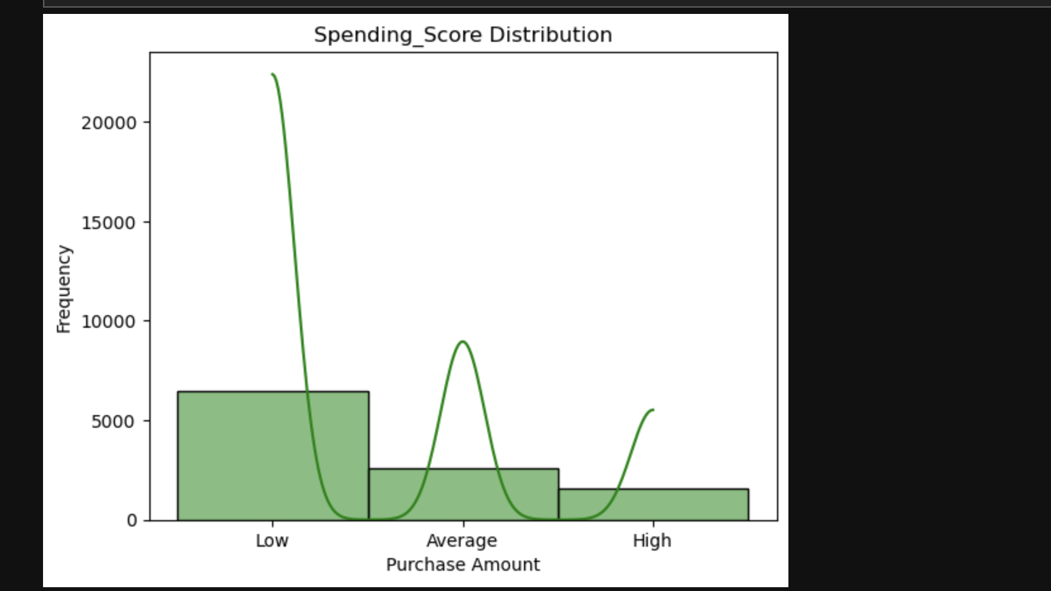
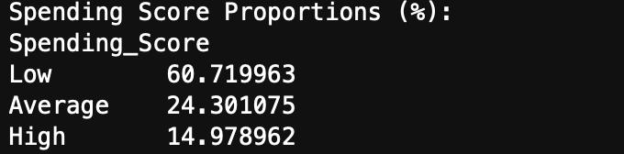

Slide 5
Spending Score Analysis
Product appeals more to low-budget customers attracting 60% of spenders

Slide 6
Solution
We can Launch a high-tier product or service line with exclusive features. Include benefits such as extended warranties, priority support, or VIP events.
Target high-spending demographics through tailored campaigns focusing on luxury, exclusivity, and superior quality. Use data analytics to identify and target look-alike audiences resembling high spenders.

Slide 7
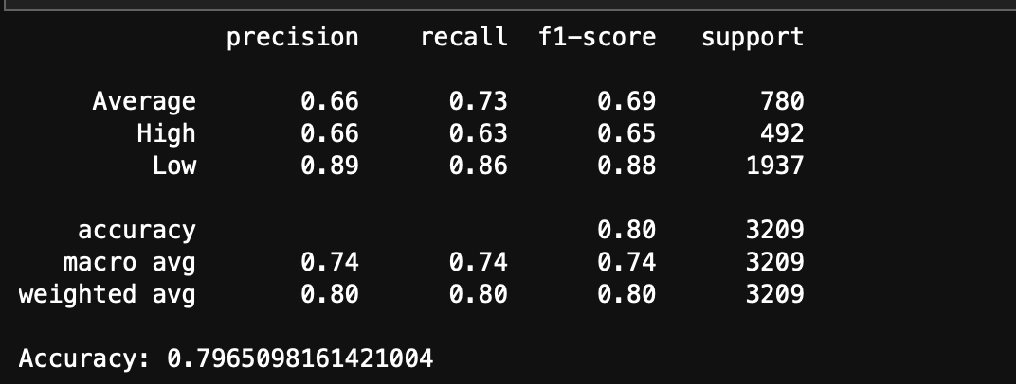
Build and train the model

Slide 8
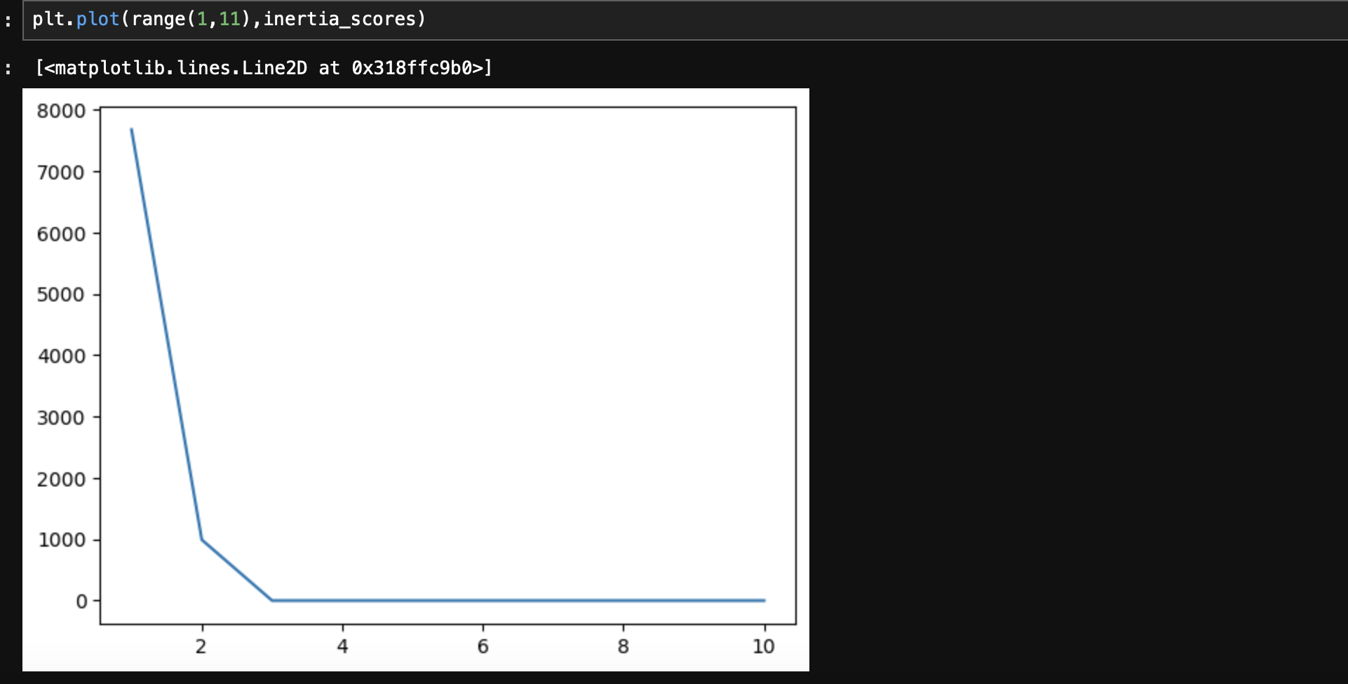
EBLOW METHOD

Slide 9
K MEANS RESULTS
The Elbow Method was used to find the optimal number of clusters for segmenting the dataset. Here's the step-by-step process:
We applied K-Means clustering for values of k=3.
For each kk, we calculated the inertia (sum of squared distances of points within a cluster to their respective centroid).

Slide 10
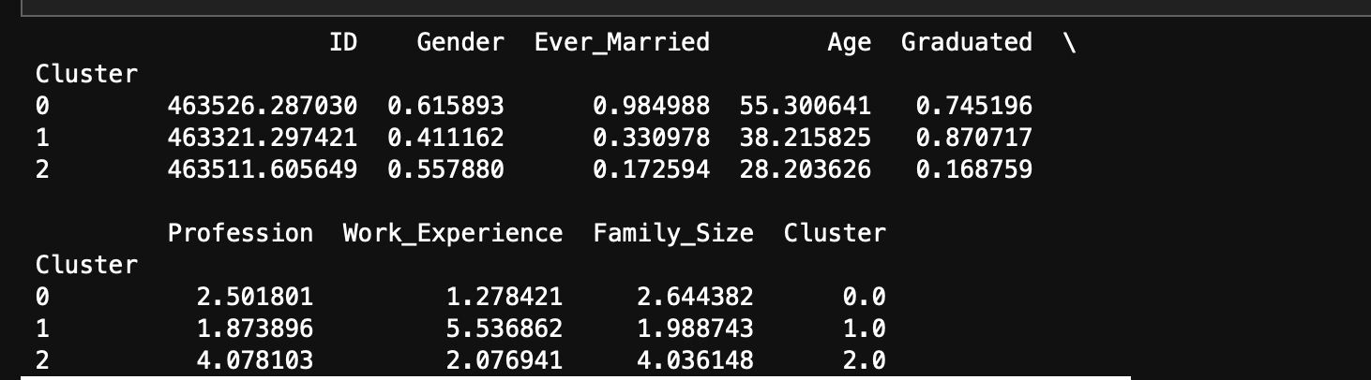
Cluster result

Slide 11
Cluster 0
Demographics:
Aged 55.3 years on average, this is the oldest group.
High proportion of individuals who are married (98.5%).
Gender split shows a slight male dominance (61.6% male).
Education and Profession:
About 74.5% graduated, indicating a moderate education level.
Average profession score of 2.50 may reflect mid-level jobs.
Lifestyle:
Low work experience of 1.28 years, possibly due to retirement or part-time work patterns.
Family size is 2.64, suggesting a nuclear family structure.

Slide 12
Cluster 1
Demographics:
Average age is 38.2 years, representing a middle-aged group.
Only 33.1% are married, indicating that the majority are single or in other statuses.
Gender ratio shows a higher female representation (41.1% male).
Education and Profession:
87.1% graduated, the highest education level among the clusters.
Profession score of 1.87, possibly reflecting entry-level or early-stage roles.
Lifestyle:
High work experience at 5.54 years, typical of individuals advancing in their careers.
Family size is 1.99, which might indicate smaller households, consistent with a younger or single demographic.

Slide 13
Cluster 2
Demographics:
Average age is 28.2 years, making this the youngest group.
Only 17.3% are married, showing this cluster is predominantly single.
Slight male dominance with 55.8% male.
Education and Profession:
Only 16.9% are graduates, the lowest education level among clusters.
Profession score of 4.08 might indicate skilled trade jobs or specialized roles.
Lifestyle:
Moderate work experience of 2.08 years, typical of early-career individuals.
Family size of 4.04, suggesting larger households or dependence on family living arrangements.

Slide 14
Business Plan

Slide 15
Business Plan Contd.

Slide 16
Marketing Program

Slide 17
Rewards Program

